Slide 1
Admin announcement
PE Dry run Saturday, April 3rd, 4-6 pm.
Was announced initially on Jan 31
Make code Reposense compatible

Slide 2

What should you unit test?
Not talking about Junit
Specifically, only about unit tests
New bugs!
Edge cases
Algorithms
Utility
Notes:
Algorithm – core logic in the application
Utility – small things that are necessary, but if they fail they can wreck havoc in the project
Edge case – you will understand after test case design. Potentially there is a failure in these regions of the code
- not necessarily in classes directly, could be things like a small loop within a large class.
After you found new bugs and fixed them, you can write tests to test around that region of the code

Slide 3
What you may NOT want to unit test?
Not talking about Junit
Specifically, only about unit tests
Trivial get*/set*
Complex interaction
Private methods
Write integration tests for these!
I/O No-op
Calls other methods/libraries
Notes:
Don’t spend effort on testing these.
Private methods are like helpers, if they are doing complex logic, yes, you should unit test them, otherwise no need
Things that do only IO, then test what is being printed, not the printing itself. If methods don’t have their own operations and only call other methods, no need to unit test such things.
ByteArrayInputStream and ByteArrayOutputStream for i/o tests – see github classroom repo

Slide 4
SUT
Test case
Test case
Test case
Test case
Test case
Test case
Test case
Test case
Test case

Slide 5
SUT
Test case
Test case
Test case
Test case
Test case
Test case
Test case
Test case
Test case
Test case

Slide 6
When do we define test cases? Are they pre-determined or on-the-fly?
SUT
Test case
Test case
Test case
Test case
Test case
Test case
Test case
Test case
Test case
Test case
Notes:
Wen you start writing your tests

Slide 7
Pre-determined or on-the-fly?
SUT
Test case
Test case
Test case
Test case
Test case
Test case
Test case
Test case
Test case
Test case
How much internal info about the SUT should be revealed to the test case designer?

Slide 8
How to choose which test cases to use and which to discard?
Pre-determined or on-the-fly?
SUT
Test case
Test case
Test case
Test case
Test case
Test case
Test case
Test case
Test case
Test case
How much info revealed?

Slide 9
Pre-determined or on-the-fly?
How to choose?
Heuristics for Better Test Case Design
How much info revealed?

Slide 10
Pre-determined or on-the-fly?
How to choose?
SUT
Test case
Test case
Test case
Test case
Test case
Test case
Test case
Test case
Test case
Test case
How much info revealed?

Slide 11
Pre-determined or on-the-fly?
SUT
Test case

Slide 12
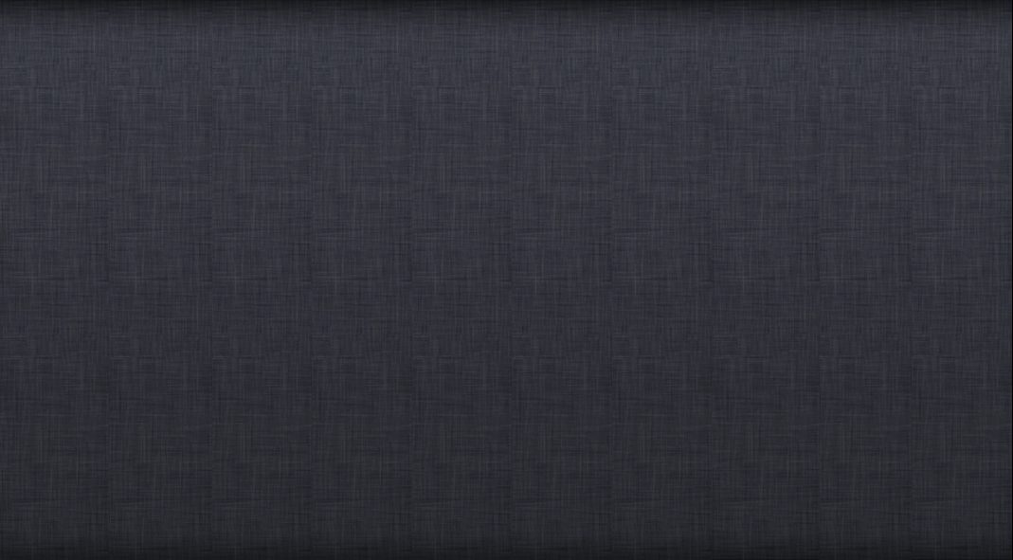

Pre-determined or on-the-fly?
SUT
Test case
scripted testing
exploratory testing
How to choose?
Notes:
Regression tests – scripted testing. Not writing a script to run test. Documenting the tests before you start running them
Following either one is not good it should be both; may not be useful to do any one of them alone

Slide 13
Pre-determined or on-the-fly?
Scripted+Exploratory
SUT
Test case

Slide 14
Pre-determined or on-the-fly?
Scripted+Exploratory
SUT
Test case

Slide 15
Scripted+Exploratory
SUT
Test case

Slide 16
Scripted+Exploratory
SUT
Test case
Test case
Test case
Test case
Test case
Test case
Test case
Test case
Test case
How much info revealed?

Slide 17
Scripted+Exploratory
SUT
Test case
Test case
Test case
Test case
Test case
Test case
Test case
Test case
Test case
How much info revealed?

Slide 18
SUT
Developer
Tester
Test case
Test case
Test case
Test case
Test case
Test case
Test case
Test case
How much info revealed?

Slide 19

SUT
Developer
Tester
Test case
Test case
Test case
Test case
Test case
Test case
Test case
Test case
How much info revealed?

Slide 20
Glass-box / a.k.a white box
Test case
Gray-box
Test case
Test case
Test case
Test case
Test case
Test case
Test case
Black-box
How much info revealed?
Notes:
You have the specification and nothing else, may be API, black box
Access to the codebase – look at the code and define the test
Gray box – partial information, e.g, size of the class and sorting

Slide 21
Test case
Test case
Test case
Test case
Test case
Test case
Test case
Test case
How much info revealed?

Slide 22
Scripted+Exploratory
SUT
Test case
Test case
Test case
Test case
Test case
Test case
Test case
Test case
Test case
Black/Glass/Gray-box

Slide 23
Scripted+Exploratory
SUT
Test case
Test case
Test case
Test case
Test case
Test case
Test case
Test case
Test case
Black/Glass/Gray-box

Slide 24
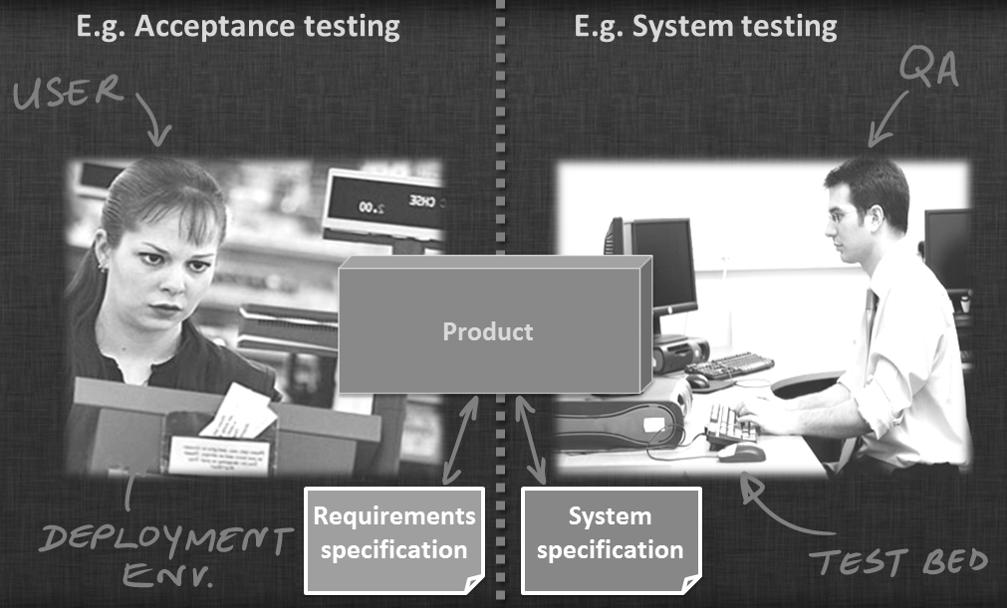
Acceptance testing is most likely to be…
Black box testing
Gray box testing
White box testing
Glass box testing
Notes:
a. Black box testing

Slide 25
How to choose?
Scripted+Exploratory
SUT
Test case
Test case
Test case
Test case
Test case
Test case
Test case
Test case
Test case
Black/Glass/Gray-box

Slide 26
How to choose?
Why choose?
Some heuristics
Test case
Test case
Test case
Test case
Test case
Test case
Test case
Test case

Slide 27
How to choose?
Why choose?
Creating test cases
Executing test cases
Test case
Test case
Test case
Test case
Test case
Test case
Test case
Test case

Slide 28
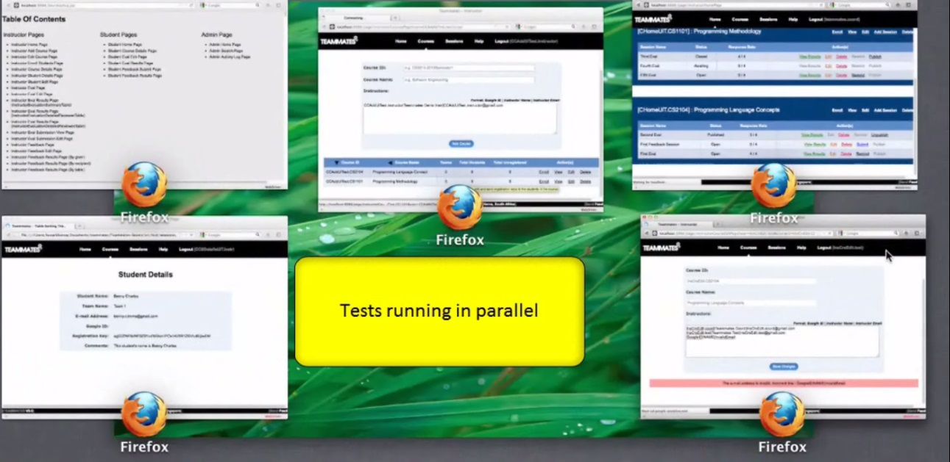
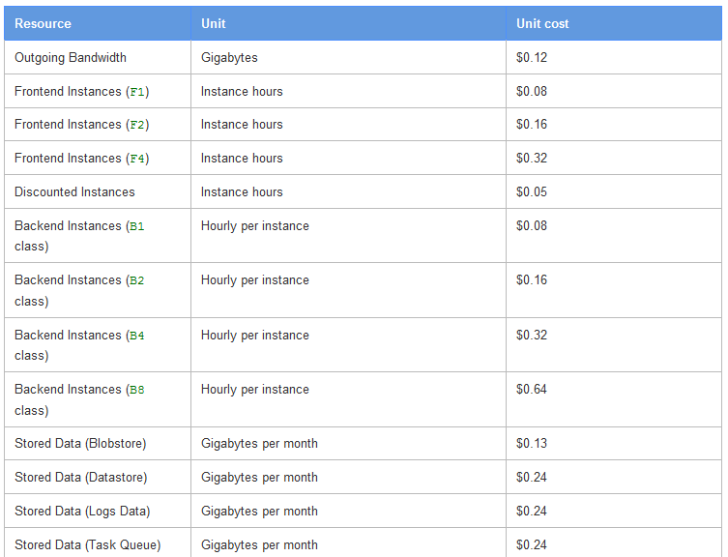
How to choose?
Why choose?
Test case
Test case
Test case
Test case
Test case
Test case
Test case
Test case

Slide 29
How to choose?
Why choose?
[Effectiveness & Efficiency]

Slide 30


How to choose?
Why choose?
Dilbert
Wally
Both tested the same system
[Effectiveness & Efficiency]
Found 20 bugs
Found 10 bugs

Slide 31
How to choose?
Why choose?
Dilbert
Wally
Both tested the same system
[Effectiveness & Efficiency]
Found 20 bugs
Found 20 bugs
Used 100 test cases
Used 40 test cases

Slide 32
How to choose?
Why choose?
[Effectiveness & Efficiency]
Guideline:
A test case should have a
reasonable chance of finding a new bug not found by other test cases.

Slide 33
How to choose?
E&E of testing
Some heuristics
Test case
Test case
Test case
Test case
Test case
Test case
Test case
Test case

Slide 34
How to choose?
E&E of testing
Some heuristics
Test case
Test case
Test case
Test case
Test case
Test case
Test case
Test case

Slide 35
How to choose?
E&E of testing
Some heuristics
Test case
Test case
Test case
Test case
Test case
Test case
Test case
Test case
Equivalence partitioning

Slide 36
How to choose?
E&E of testing
Some heuristics
Test case
Test case
Test case
Test case
Test case
Test case
Test case
Test case
Equivalence partitioning

Slide 37
Equivalence partitioning

Slide 38
Equivalence partitioning
isValidMonth (int m): boolean
Description:
checks if m is in the range [1..12]. returns true if m is in the range, false otherwise.
Positive/negative?
Hmmm… interesting.
Let me try 275
Pass/fail?
Test Case 12
Test Case 13
Test case 23:
Input: 273
Expected: false
Test case 23:
Input: 274
Expected: false
Should he?
Why not?
Actual: true
Actual: true

Slide 39
Equivalence partitioning
isValidMonth (int m): boolean
275
273
274
Must be broken too!
Broken!
Broken!

Slide 40
Equivalence partitioning
isValidMonth (int m): boolean
275
273
274

Slide 41
Equivalence partitioning
isValidMonth (int m): boolean
MIN_INT
0
1
12
13
MAX_INT
275
273
274

Slide 42
Equivalence partitioning
isValidMonth (int m): boolean
MIN_INT
0
1
12
13
MAX_INT

Slide 43
Equivalence partitioning
Input space
Output space
SUT

Slide 44
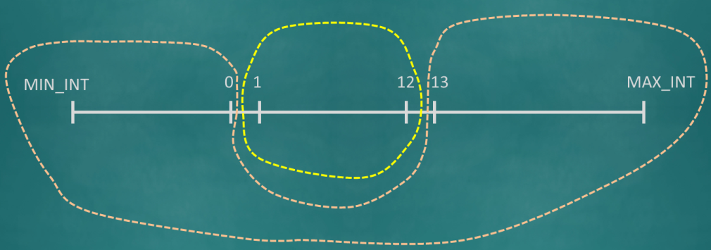
Equivalence partitioning
Input partition 1
Input partition 2
Input partition 3
Output 1
Output 2
Output 3
Input space
Output space
Input partition 1a
SUT
➔true
➔false

Slide 45
Equivalence partitioning
Input partition 1
Input partition 2
Input partition 3
Output 1
Output 2
Output 3
Input partition 1a
SUT
Input partition 1b
➔true
➔false
➔false

Slide 46
Equivalence partitioning

Slide 47
What are the EPs for name in the method below?
/**
* Adds the name to the course list.
* @param name must be between 5 to 50 chars (both inclusive)
* and not already in the course list
*/
void addName(String name) { … }
Len [5..50]
Case sensitivity?
Leading/trailing spaces?
Len < 5
in the list
not in the list
Len > 50
null
Empty string

Slide 48



Equivalence partitioning
How many equivalence partition?
int square (int i)
Description: returns the square value of i

Slide 49
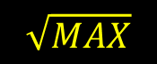


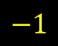
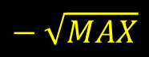
Equivalence partitioning
int square (int i)
Description: returns the square value of i
$MIN$
$$− \sqrt{MAX}$$
$$−1$$
$$\sqrt{MAX}$$
$$MAX$$
0

Slide 50
Equivalence partitioning
int square (int i)
Description: returns the square value of i
$MIN$
$$− \sqrt{MAX}$$
$$−1$$
$$\sqrt{MAX}$$
$$MAX$$
0

Slide 51
How to choose?
E&E of testing
Some heuristics
Test case
Test case
Test case
Test case
Test case
Test case
Test case
Test case
Equivalence partitioning
It helps to improve E&E by …
Reduce redundancy
Reduce unnoticed bugs

